Slide 1
Evolve 2016 Experience
Allan Pead
Xamarin Insider
@adpead / apead@adsoftsystems.co.za
Notes:
Xamarin Introduction!

Slide 2

Xamarin Evolve is the largest cross-platform mobile event in the world, where over 1,500 developers, industry leaders, and Xamarin experts converge to advance the state of the art, discuss mobile strategy, and define the future of apps.
Notes:
Xamarin Evolve 2016 was largest Evolve yet. 1,700 mobile developers attended. Tens of thousands of developers from 152 countries on the live stream.
70 Speakers

Slide 3
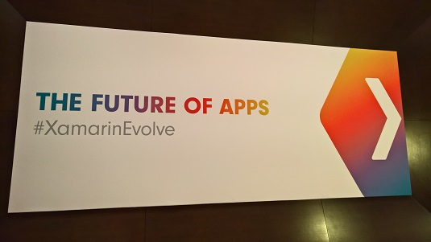

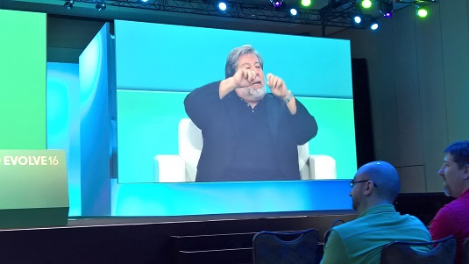
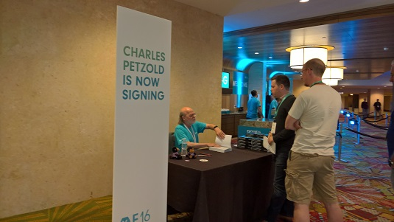
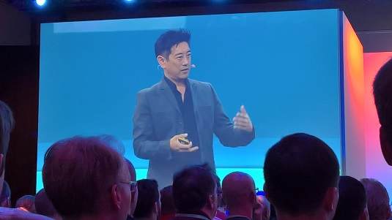
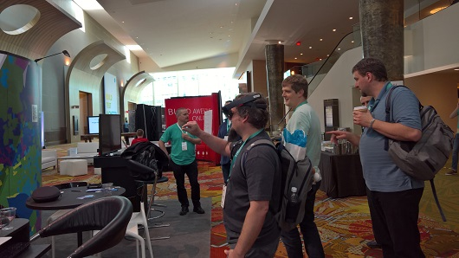
Evolve: Disney World for Developers

Slide 4
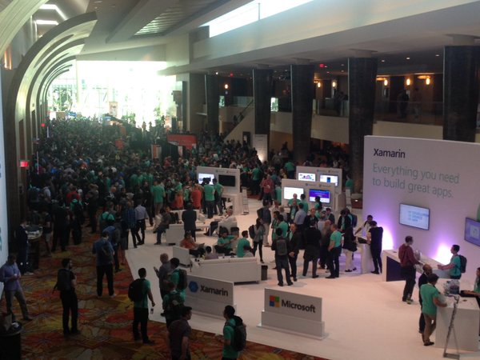

Slide 5


Hyatt Regency • Orlando, FL • April 24–28, 2016

Slide 6
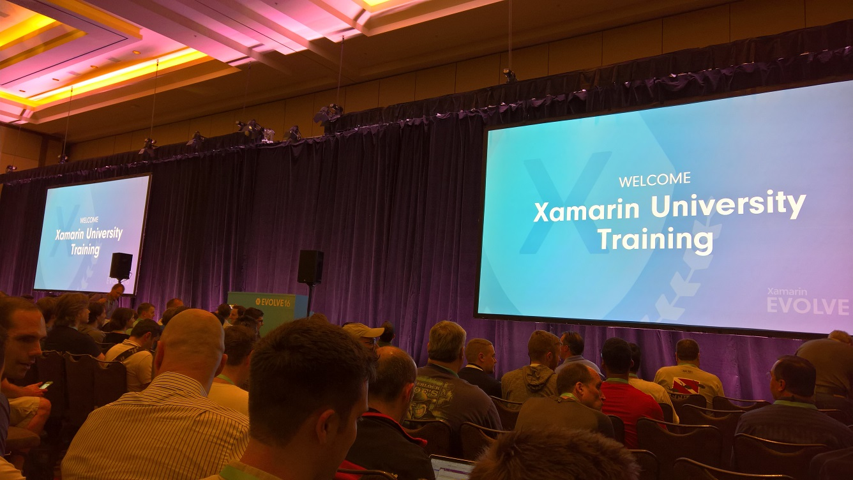

Slide 7
2 days Training
Fundamentals Track The Xamarin Mobile Platform Introduction to Xamarin.Forms Defining UI in XAML Cross-platform code strategies Working with REST services Data binding and MVVM Using the Xamarin.Forms | Intermediate Track Keeping your apps responsive Design patterns for cross-platform code sharing UI and Unit Testing with Xamarin Securing Local Data Authenticating with OAuth Diagnosing common memory issues

Slide 8
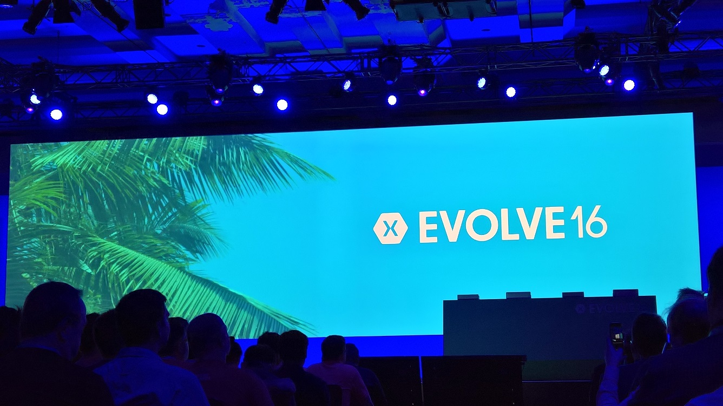

Slide 9
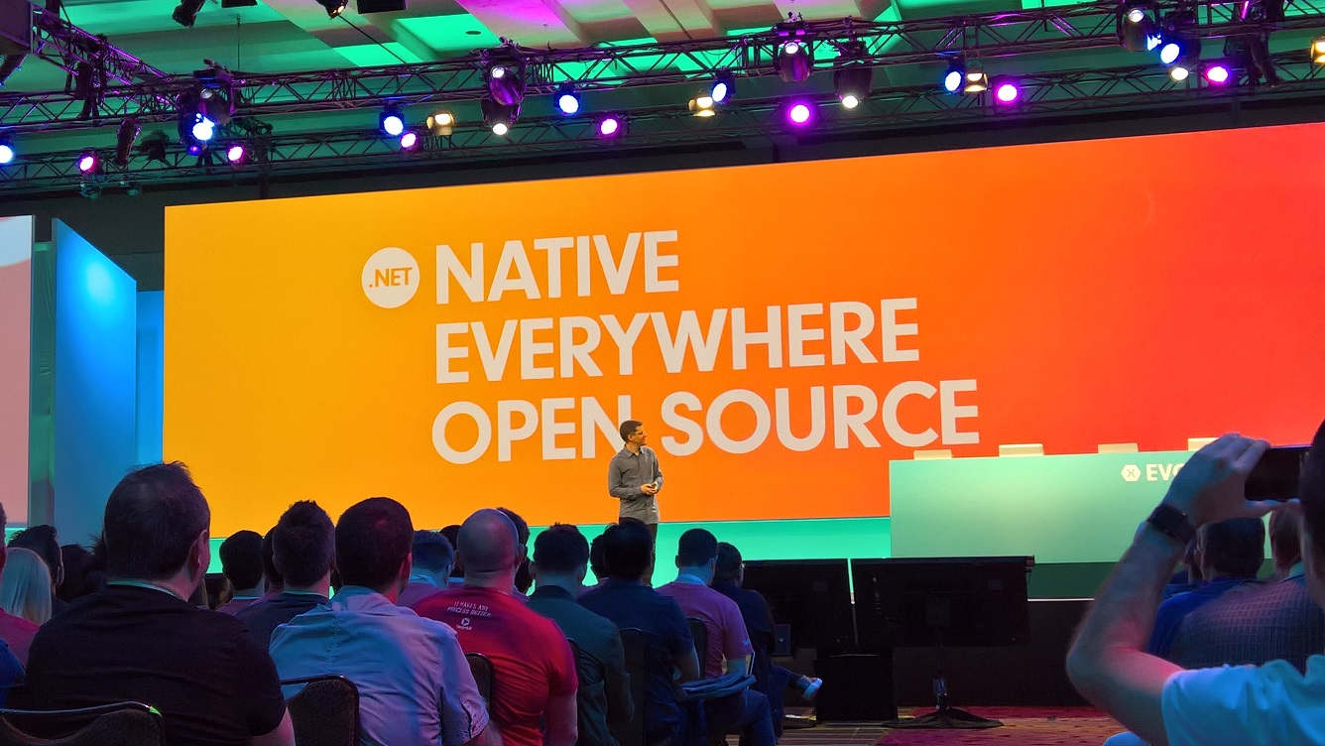
Keynote highlights…
Xamarin Open Source
http://open.xamarin.com/
Mono MIT License
https://github.com/mono/mono/blob/master/PATENTS.TXT

Slide 10
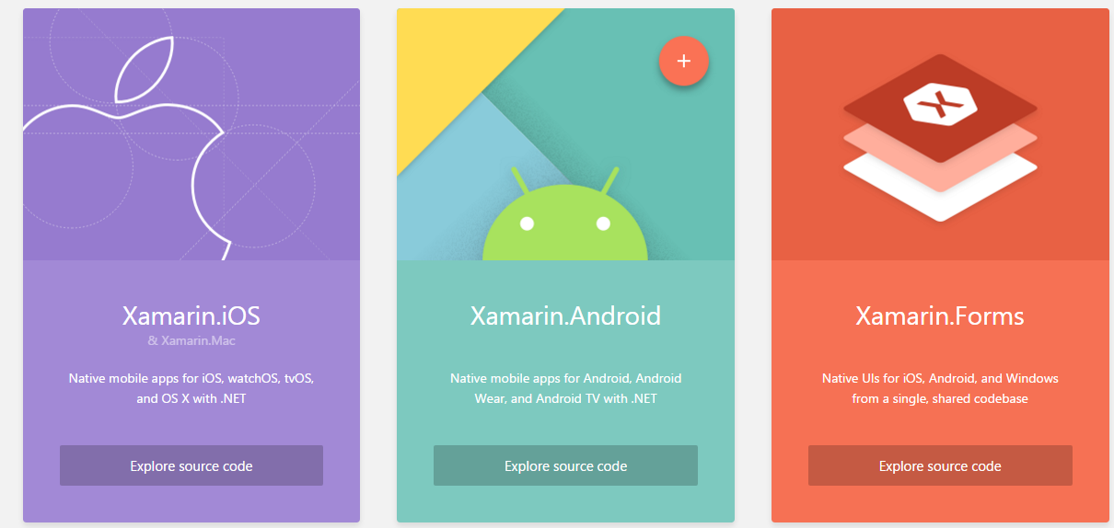
Keynote highlights…
Xamarin Open Source

Slide 11
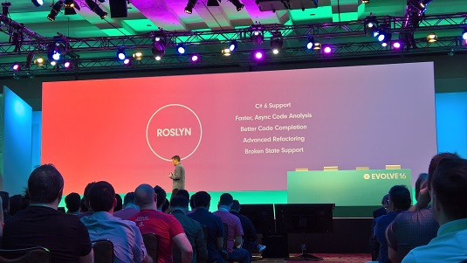
Keynote highlights…
Xamarin Studio 6
Complete redesign
Over 5,000 new icons
Dark theme
Improved syntax highlighting.
Type system rewritten to use Roslyn
Support for C# 6.
Greater compatibility with Visual Studio projects.

Slide 12
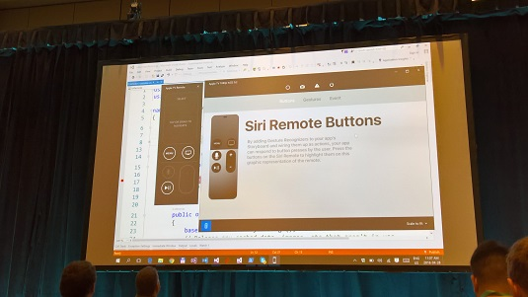
Keynote highlights…
Visual Studio
New iOS Simulator
iOS USB remoting

Slide 13
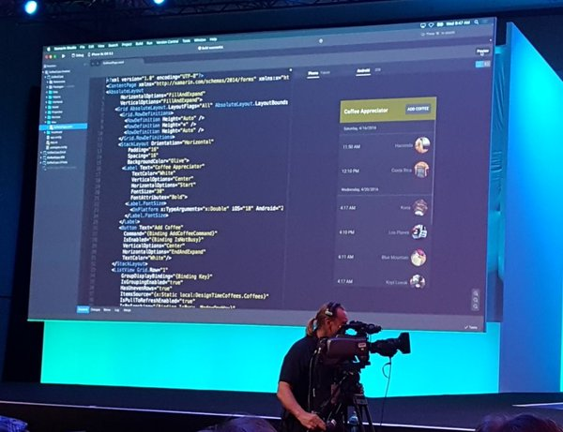
Keynote announcements…
Xamarin.Forms Updates
Themes
DataPages
URL Navigation
Embedded Platform-Specific Controls
Xamarin.Forms Previewer

Slide 14
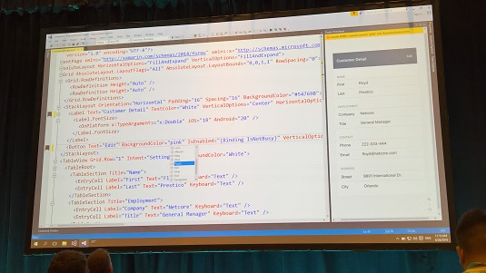
Keynote highlights (hidden)…
Xamarin Forms Previewer in Visual Studio

Slide 15
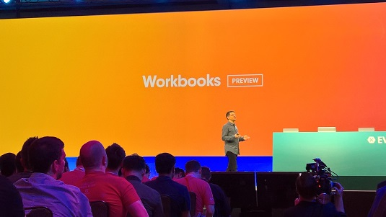
Keynote highlights…
Workbooks
Workbooks are live code documents
Great for experimenting, teaching, training, or exploring mobile development in C#.
Notes:
https://t.co/ZnMg0pb40a

Slide 16
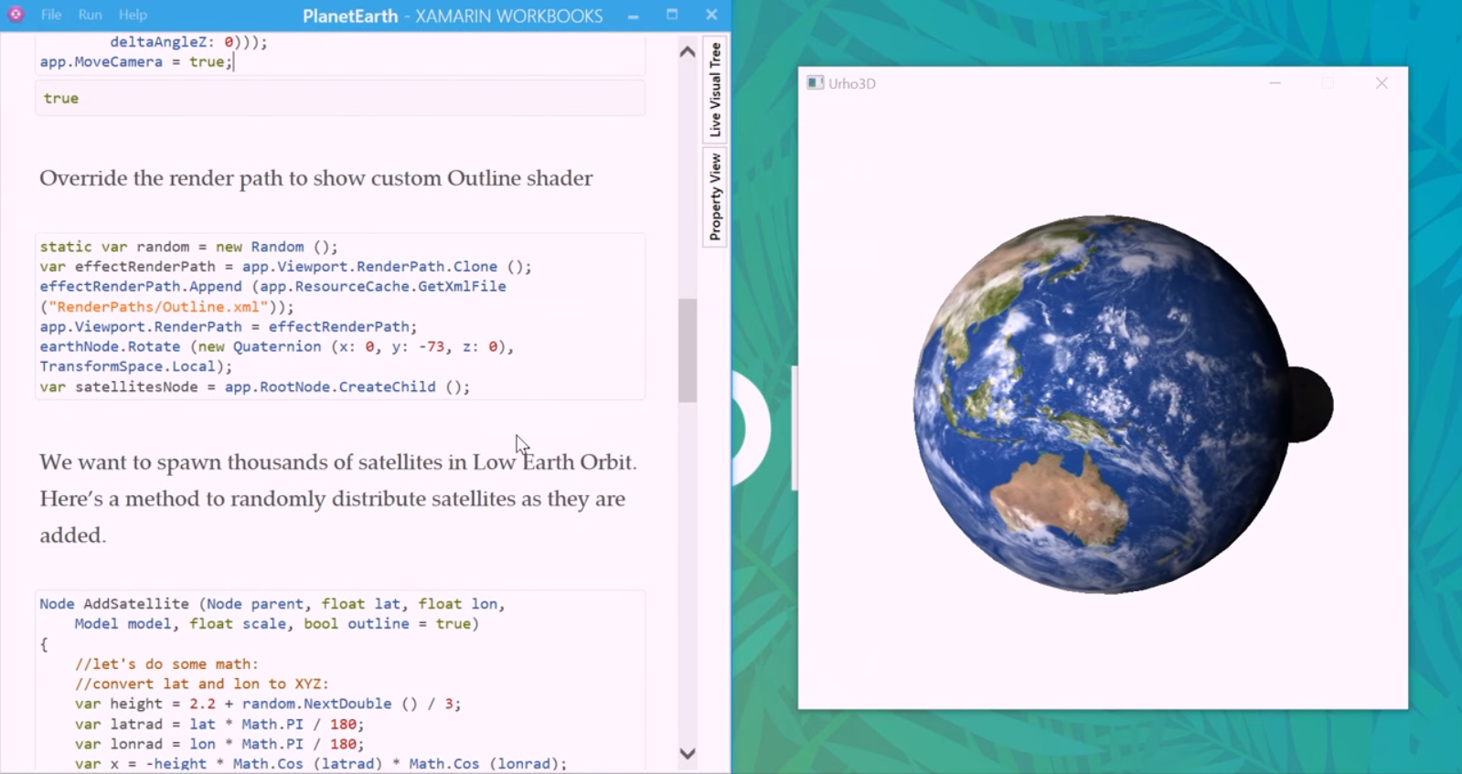
Workbooks
Notes:
https://t.co/ZnMg0pb40a

Slide 17
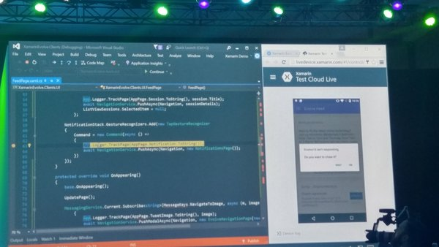
Keynote highlights…
The Mobile-Optimized Development Lifecycle
Test Cloud Live
Xamarin Test Recorder for Visual Studio
Deliver, Monitor, Iterate: Xamarin Insights and HockeyApp are joining
Notes:
2,000 real devices

Slide 18
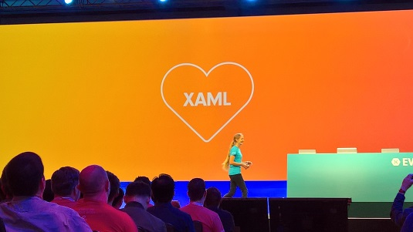
Xamarin and Microsoft
Xamarin
And
Microsoft
Love

Slide 19
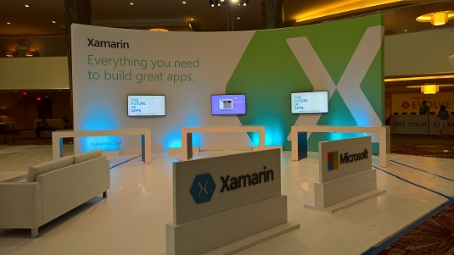
Xamarin and Microsoft

Slide 20
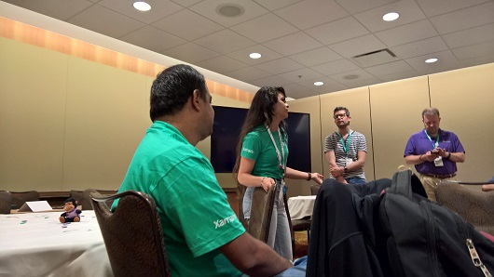


Xamarin Evolve – Events within the Event

Slide 21

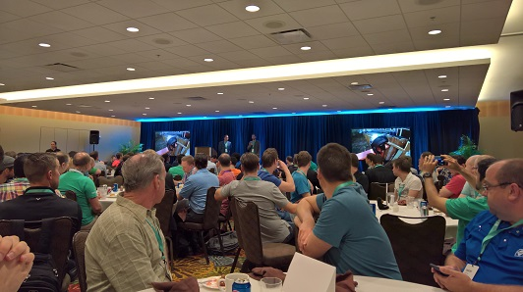
Xamarin Evolve - Events within the Event

Slide 22

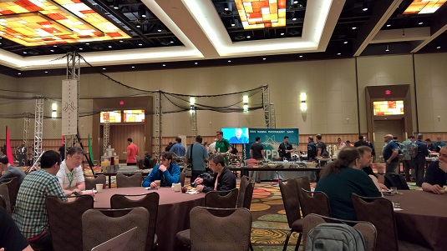
Xamarin Evolve Fun

Slide 23
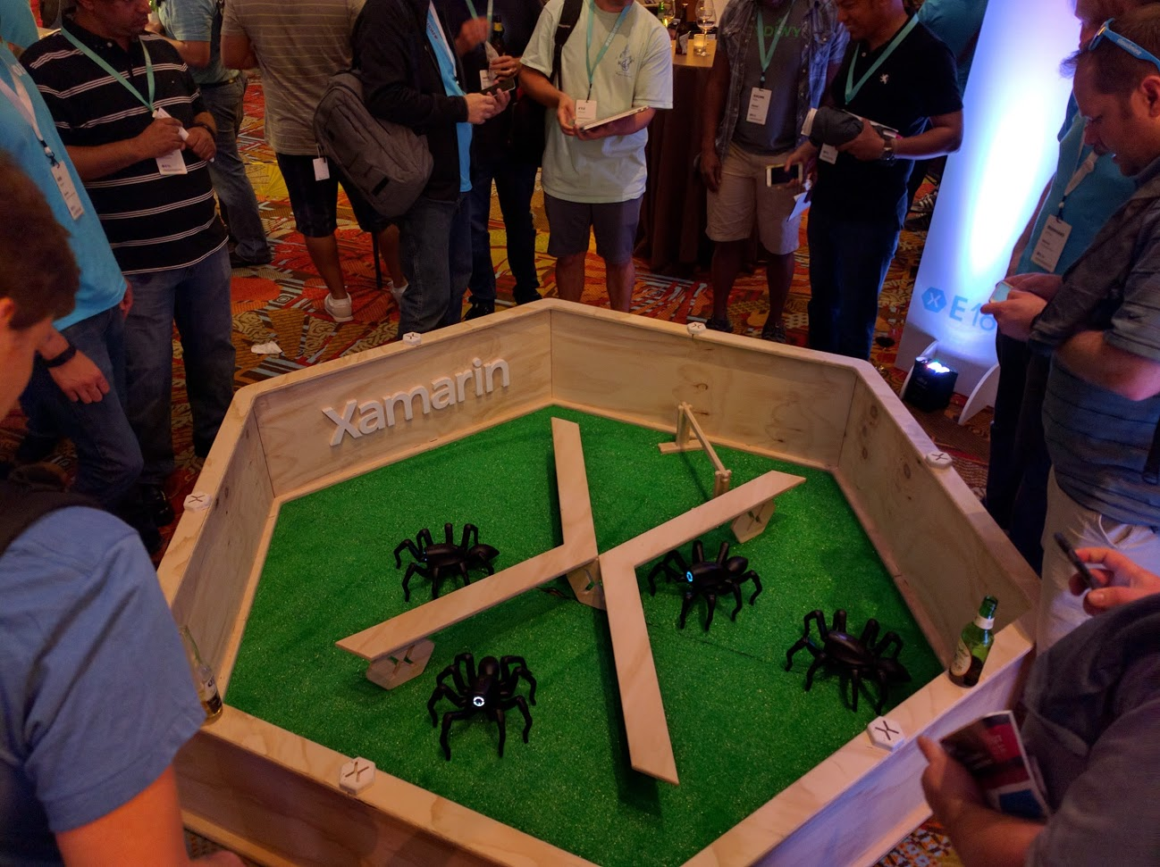
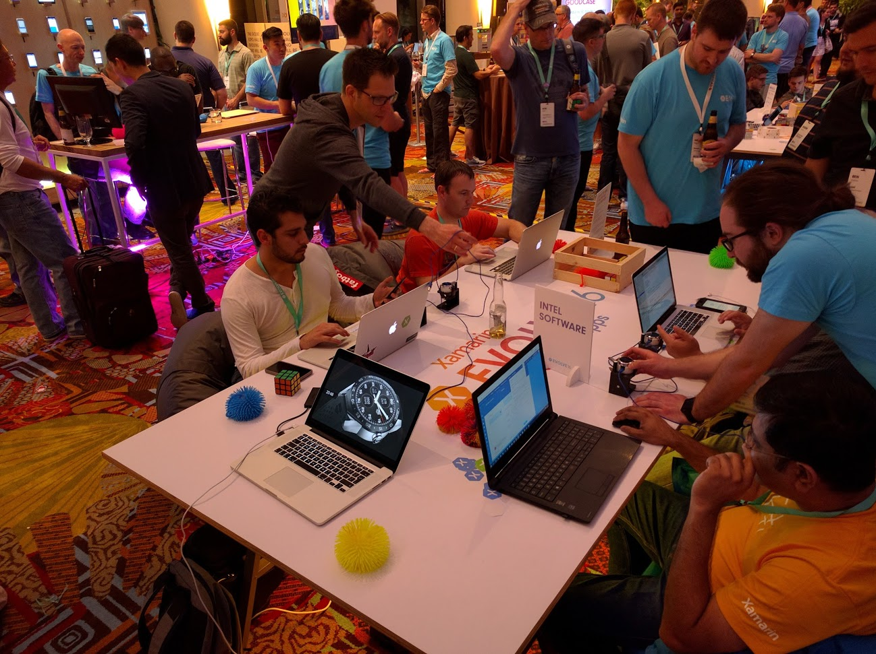
Darwin Lounge…

Slide 24
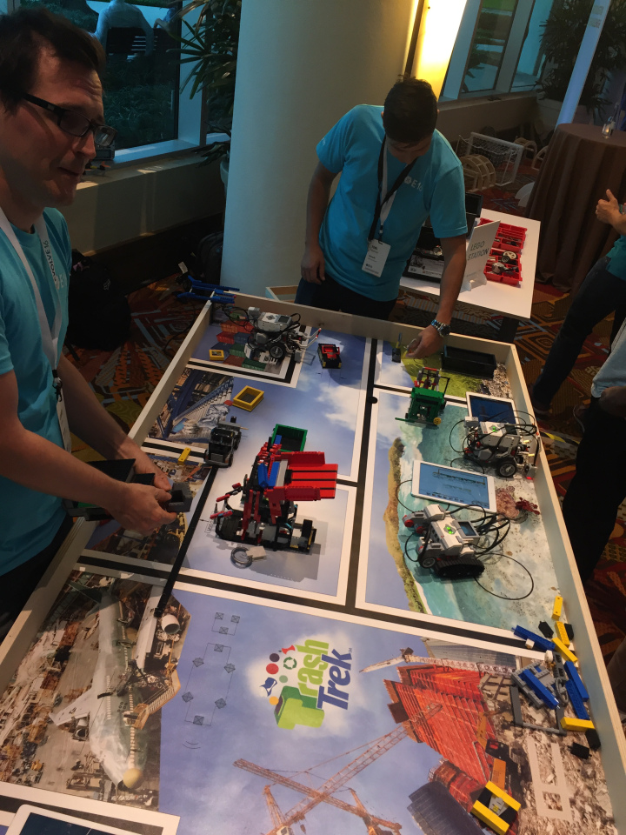
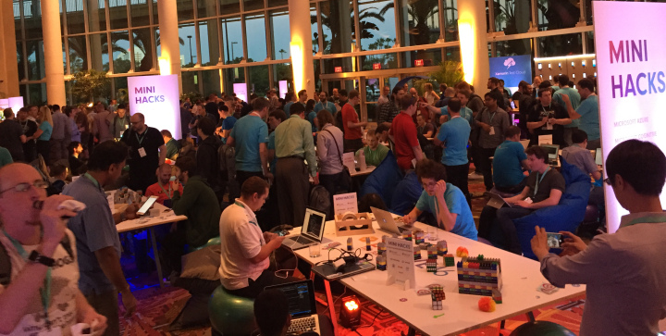
Darwin Lounge…

Slide 25
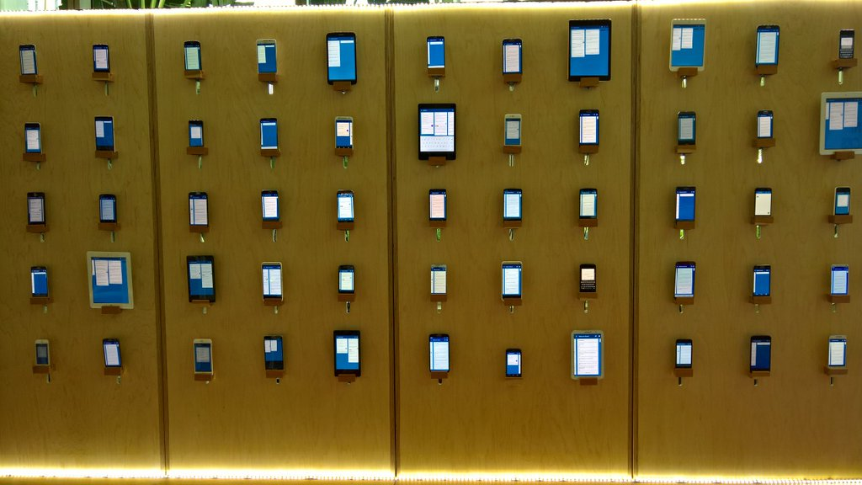

Darwin Lounge…

Slide 26
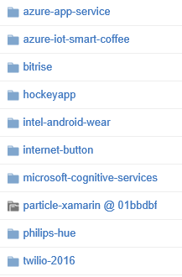

Darwin Lounge…
Mini hacks
https://github.com/xamarin/mini-hacks

Slide 27

Xamarin Developer DNA

Slide 28


Evolution Meets Imagination

Slide 29




Slide 30




Slide 31
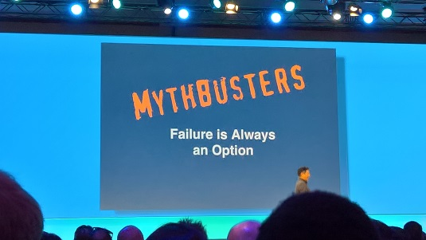
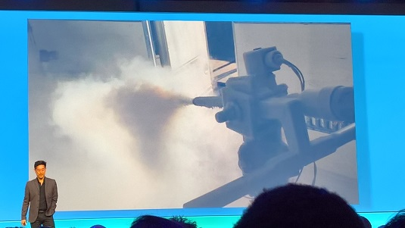
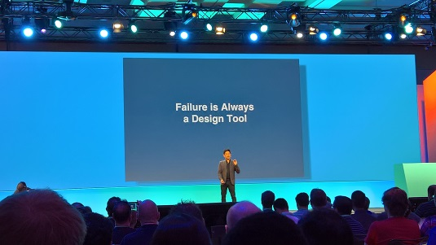
Grant Imahara

Slide 32
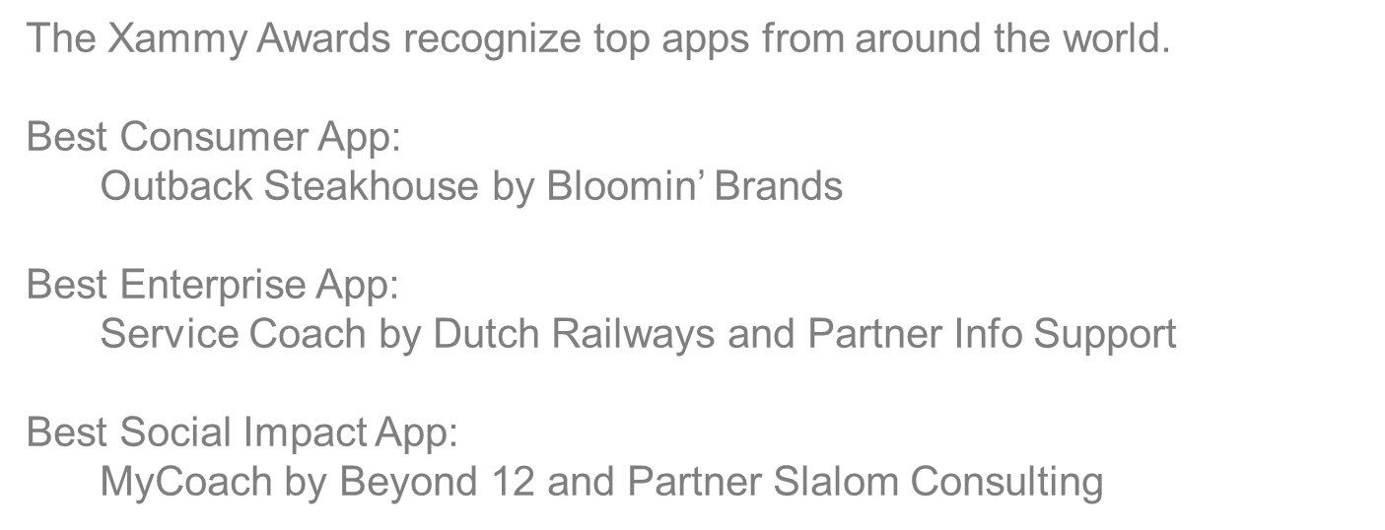
Xamarin Evolve 2016 Closing
Xammy Awards

Slide 33
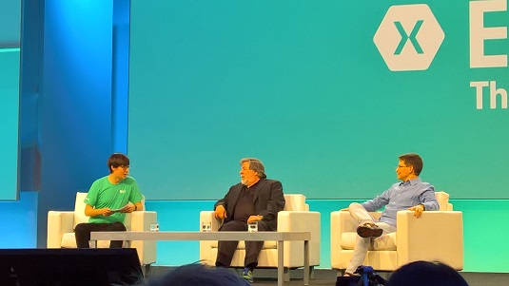
Xamarin Evolve 2016 Closing

Slide 34

Xamarin Evolve 2016 Sessions
All recorded sessions available at: https://evolve.xamarin.com
or direct you tube links: http://bit.ly/1T0Vv3t

Slide 35
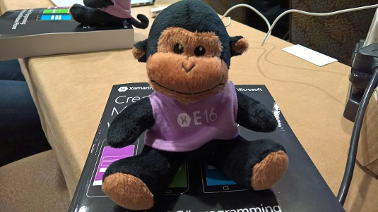
But what about me?

Slide 36
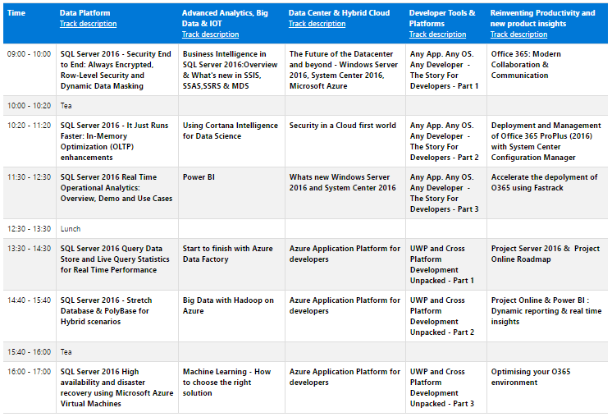
Other Xamarin Events in South Africa
Microsoft Empower
Technical Summit

Slide 37
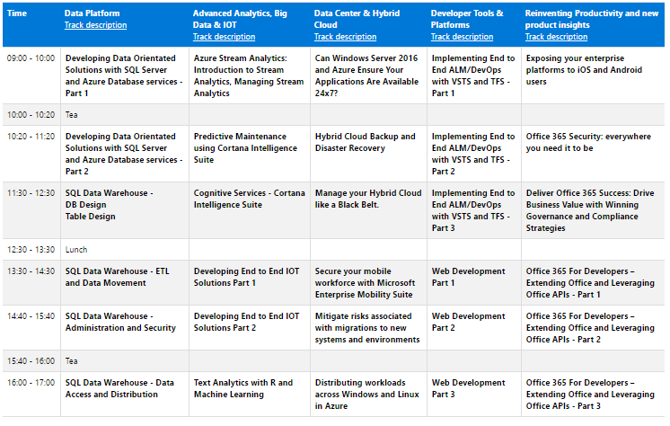
Other Xamarin Events in South Africa

Slide 38
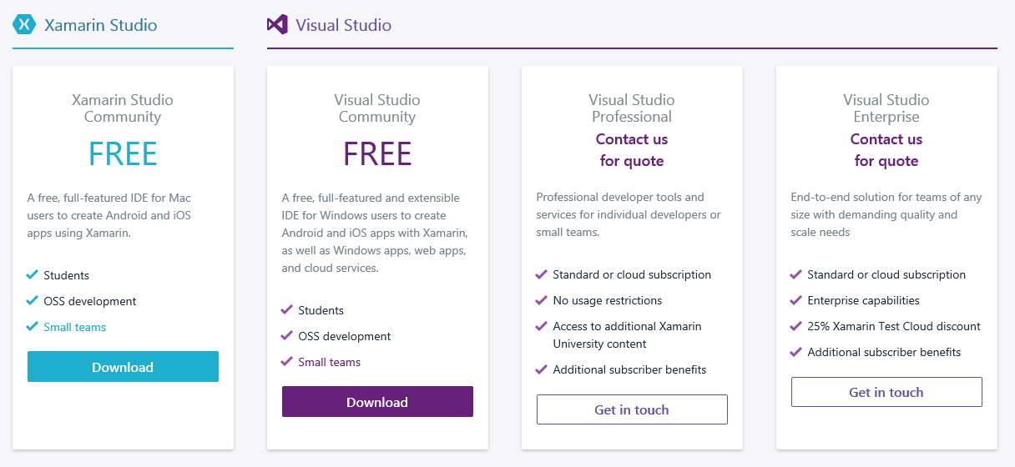
How Free is Xamarin really…

Slide 39
